Slide 1

Cochin University College of Engineering Kuttanadu
Cochin University of Science and Technology
Seminar
Traffic Prediction for Intelligent Transportation System using M.L
Name : Rahul Kumar
Branch : MCA 4th Semeseter
Reg. No : 38119227
Guide : Fanny Miss

Slide 2
Table Of Contents
1. Introduction.................................................................................1
2. Intelligent Transport Technolgies................................................2
2.1 Wireless Communication......................................................3
2.2 Computational Technologies.................................................5
2.3 Floating Car Data..................................................................7
2.4 Inductive Loop Detection&Sensing Data.............................9
2.5 Video Vehicle Detection.......................................................13
3. Intelligent Transport Application................................................15
3.1 Emergency Vehicle Notification Detection...........................15
3.2 Automatic Road Enforcement...............................................16
3.3 Variable Speed Limit……………………………………….18
3.4 Collision Avoidance System…………………………....…..19
3.5 Dynamic Traffic Light Sequence……………………….…..20
4. Conclusion………………………………………………….…..21
5. Reference…………………………………………………….…22

Slide 3
1. Introduction-
Intelligent Transport System refers to information and communication technology to transport infrastructure and vehicles , that improves transport outcomes :
Transport Safety
Transport Productivity
Travel Reliability
Informed Travel
Social Enquiry
Environment Performance
Network Operation Resilience
1

Slide 4
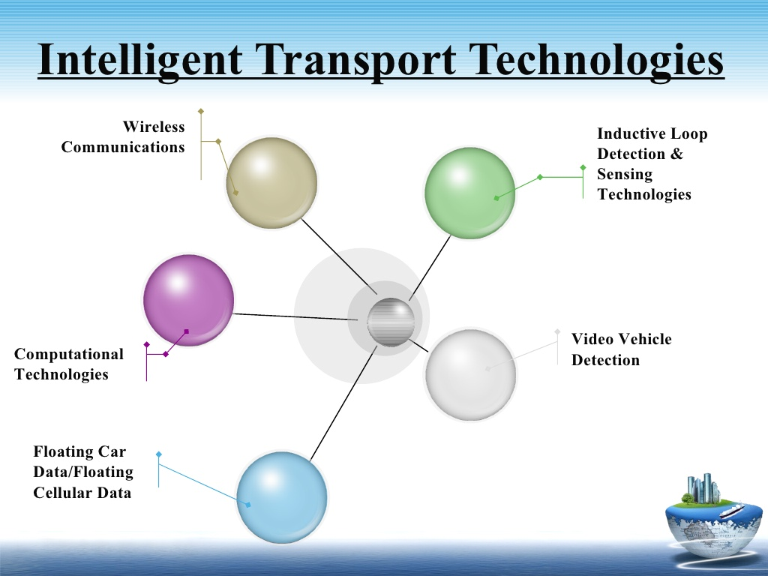
Intelligent Transport Technologies
2

Slide 5
Wireless Communication
Radio modern communication on UHF and VHF frequencies used for short and long range
Short range (less than 450m) proposed using IEEE protocols
Long range proposed using infrastructure networks like WiMAX(IEEE)
3

Slide 6
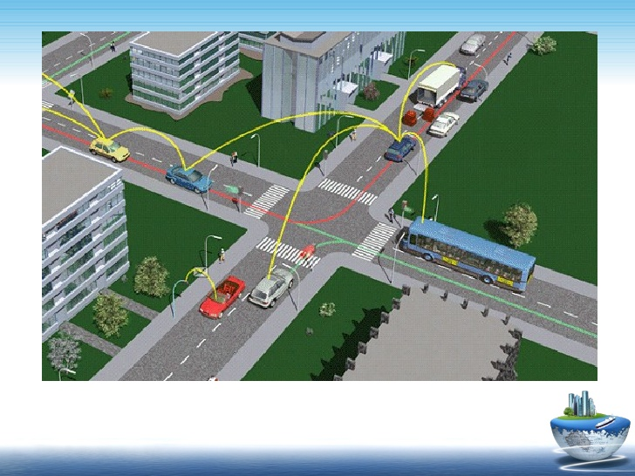
Fig
4

Slide 7
Computation Technologies
A typical vehicle in the early 2000s would have between 20 and 100 individual networked microcontroller/Programmable logic controller modules with non-real-time operating systems.
The current trend is toward fewer, more costly microprocessor
modules with hardware memory management and Real-Time
Operating Systems.
5

Slide 8
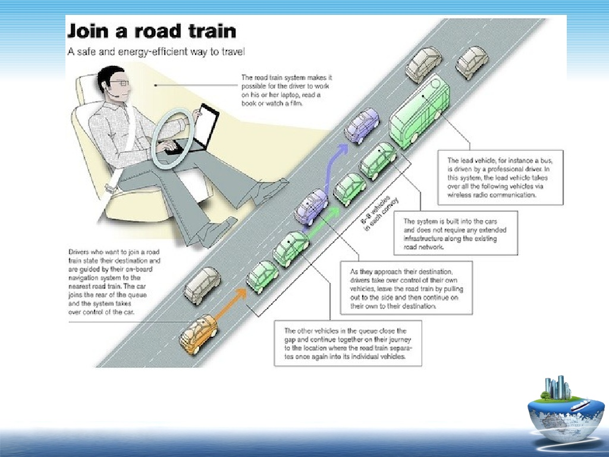
Fig
6

Slide 9
Floating Car Data
"Floating car" or "probe" data collection is a set of relatively lowcost methods for obtaining travel time and speed data for vehicles traveling along streets, highways, freeways, and other transportation routes.
Broadly speaking, three methods have been used to obtain the raw data:
▪ Triangulation Method
▪ Vehicle Re-Identification
▪ GPS Based Methods
7

Slide 10
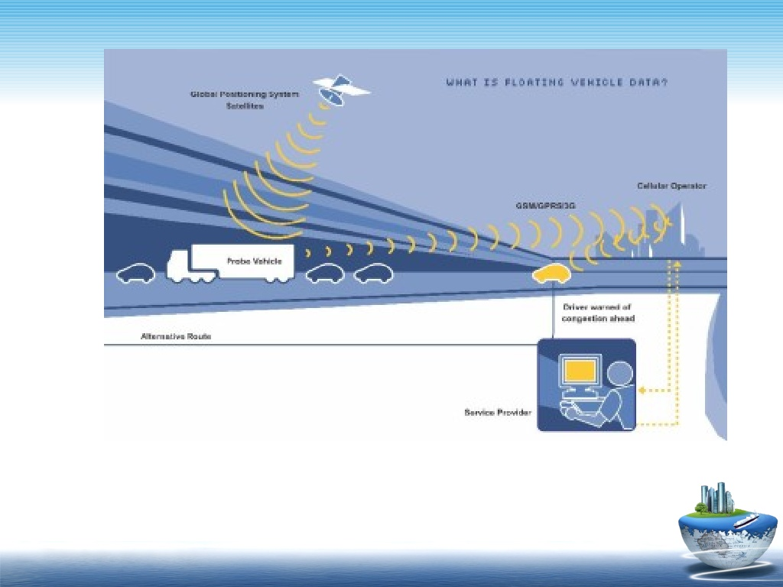
What is floating Vehicle Data
8

Slide 11
Sensing Technologies
Technological advances in telecommunications and information technology, coupled with state-of-the-art microchip, RFID (Radio Frequency Identification), and inexpensive intelligent beacon sensing technologies, have enhanced the technical capabilities that will facilitate motorist safety benefits for intelligent transportation systems globally.
9

Slide 12
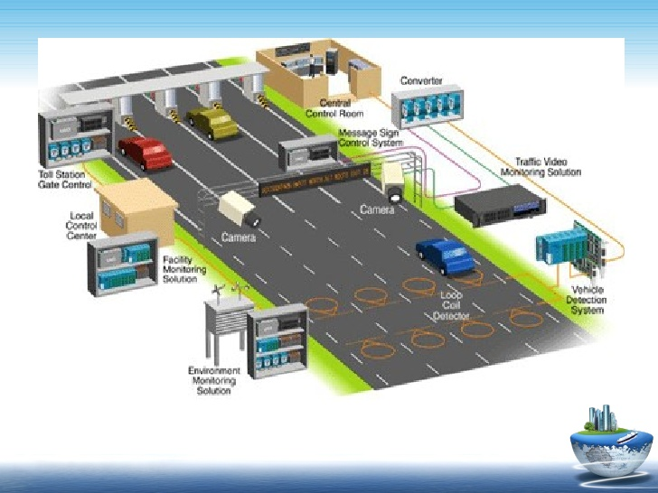
Fig
10

Slide 13
Inductive Loop Detection
Inductive loops can be placed in a roadbed to detect vehicles as they pass through the loop's magnetic field. The simplest detectors simply count the number of vehicles during a unit of time (typically 60 seconds in the United States) that pass over the loop.
While more sophisticated sensors estimate the speed, length, and weight of vehicles and the distance between them.
11

Slide 14
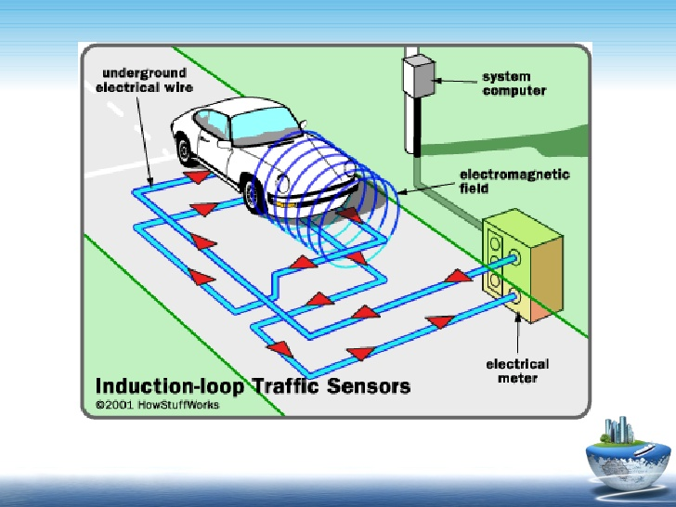
Fig
12

Slide 15
Video Vehicle Detection
Traffic flow measurement and automatic incident detection using video cameras is another form of vehicle detection. Since video detection systems such as those used in automatic number plate recognition do not involve installing any components directly into the road surface or roadbed, this type of system is known as a "nonintrusive" method of traffic detection.
Video from black-and-white or color cameras is fed into processors that analyze the changing characteristics of the video image as vehicles pass. The cameras are typically mounted on poles or structures above or adjacent to the roadway.
13

Slide 16
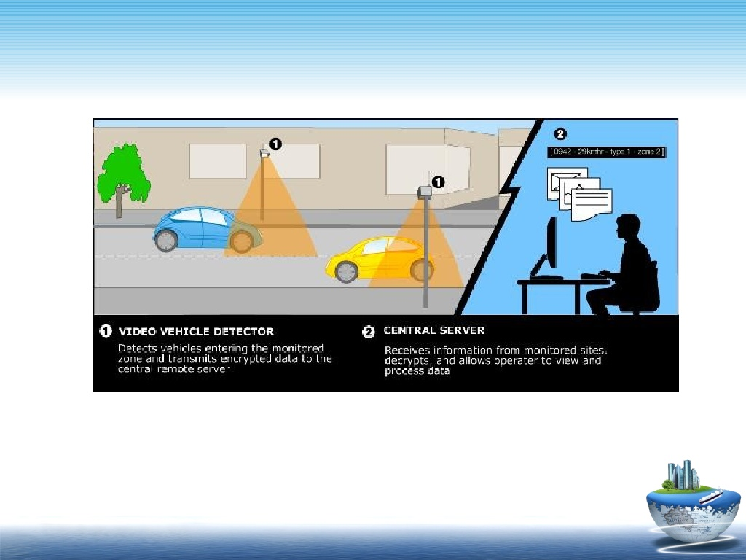
Fig
14

Slide 17
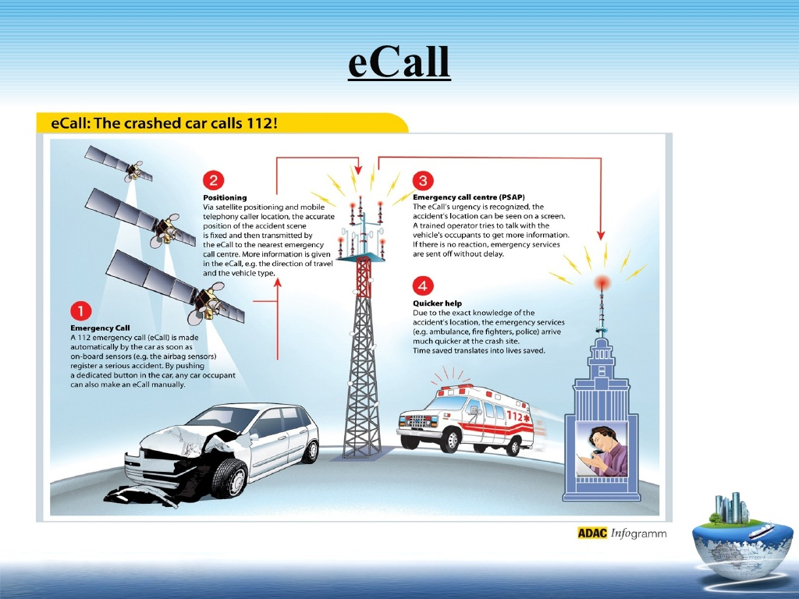
Intelligent Transport Application
1.Emergency Vehicle Notification System
15

Slide 18
2. Automated Road Enforcement
1. Speed cameras
2. Red light cameras
3. Bus lane cameras
4. Level crossing cameras
5. Double white line cameras
6. High-occupancy vehicle lane cameras
16

Slide 19
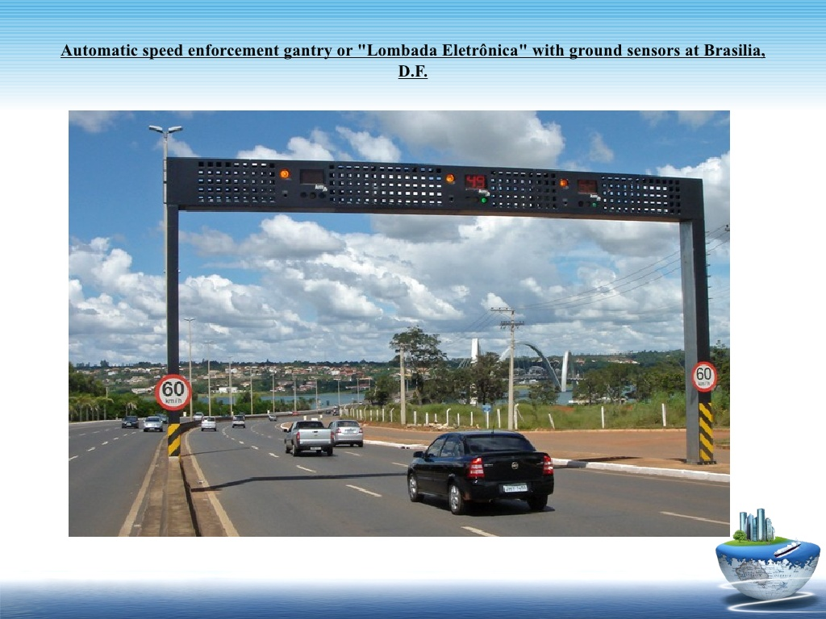
Fig
17

Slide 20
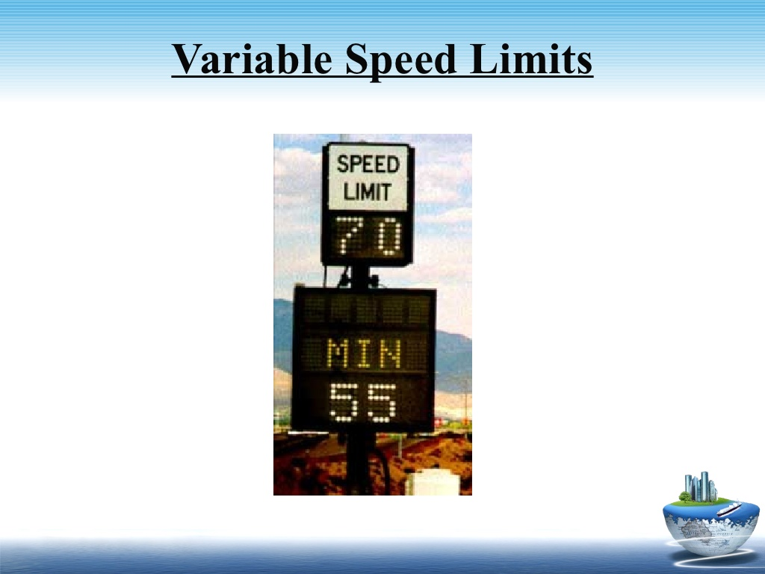
3 . Variable Speed Limit
18

Slide 21
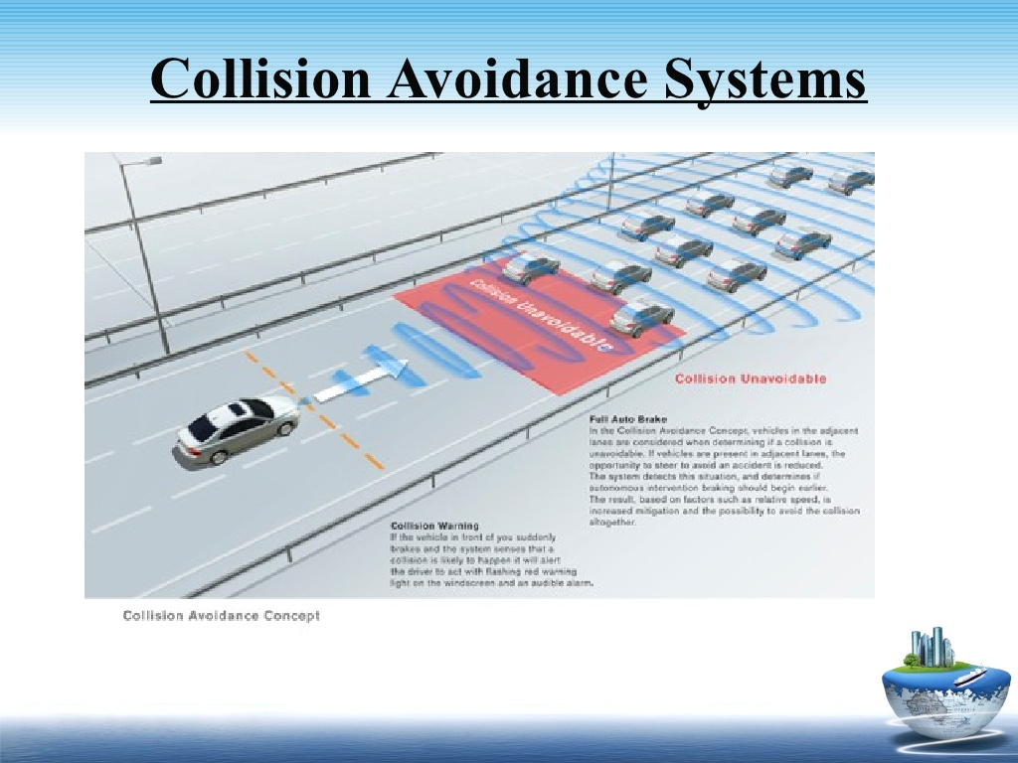
4. Collision Avoidance System
19

Slide 22
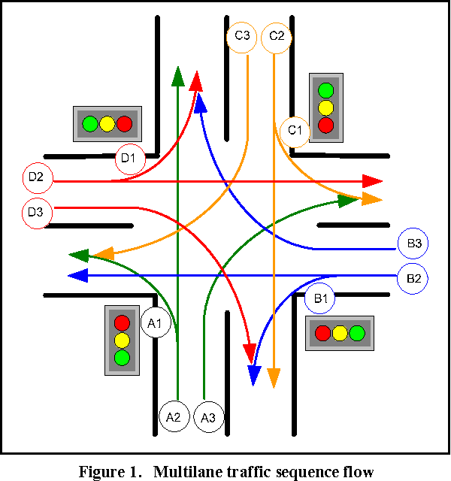
5. Dynamic Traffic Light Sequence
²⁰

Slide 23
Conclusion :
Although deep learning and genetic algorithm is an important problem in data analysis, it has not been dealt with extensively by the ML community.
The proposed algorithm gives higher accuracy than the existing algorithms also, It improves the complexity issues throughout the dataset.
21

Slide 24
Reference:
[1] Fei-Yue Wang et al. Parallel control and management for
intelligent transportation systems: Concepts, architectures, and applications.IEEE Transactions on Intelligent Transportation Systems,2010.
[2] Yongchang Ma, Mashrur Chowdhury, Mansoureh Jeihani, and Ryan Fries. Accelerated incident detection across transportation networks using vehicle kinetics and support vector machine in cooperation with infrastructure agents. IET intelligent transport systems, 4(4):328–337,2010.
22

Slide 25
Thank You!
23

